Slide 1

Hi, i’m Daniil

Slide 2
i’m from H&M translation service

Slide 3

problem
want a gpt translator!
no need in fast response
initial load 10_000 words to 50 languages per working day

Slide 4

concerns
release fast!
wait, wait, wait for gpt response
extendable service

Slide 5
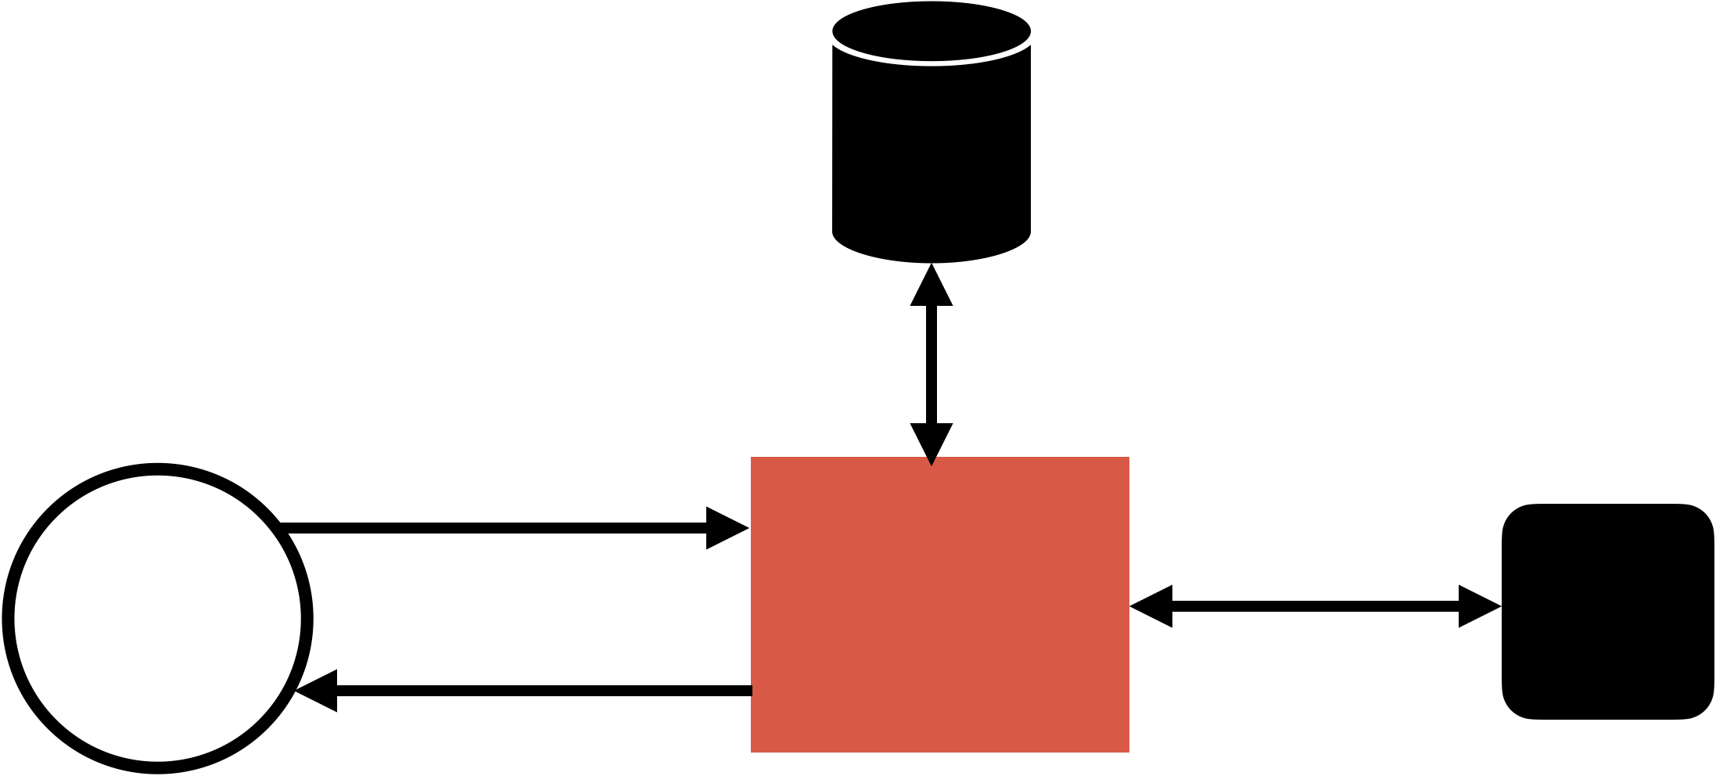
idea
postgres
(events
& locks)
±. Persist events,
build prompts
1. Submit master copy
2. Ask for translation
translation
service
gpt-translation
-provider
any LLM
3. Notify – translation ready

Slide 6
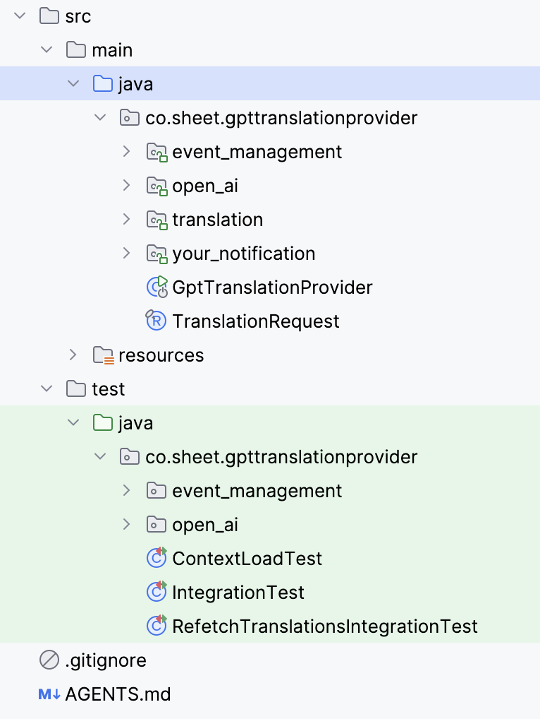
tech
Spring Boot 3, Modulith, JDBC
Java 21-25
Maven

Slide 7
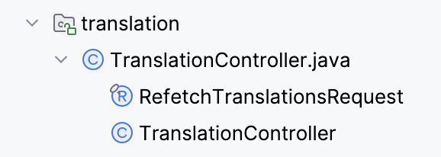
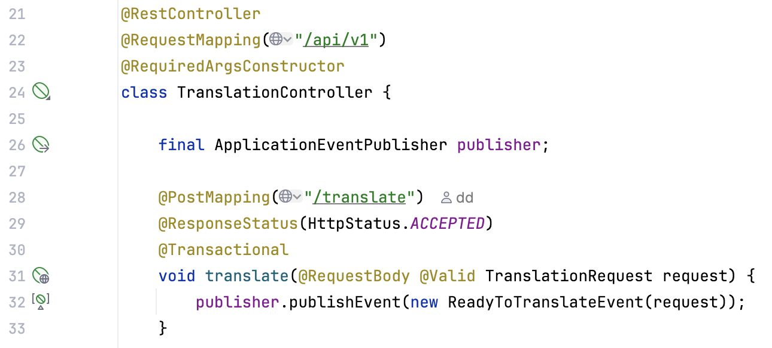
modulith

Slide 8
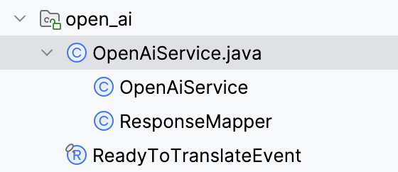
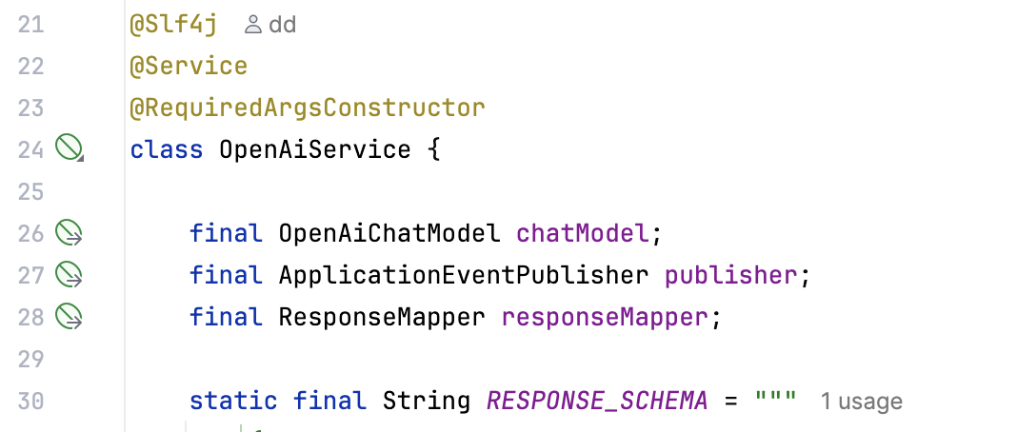
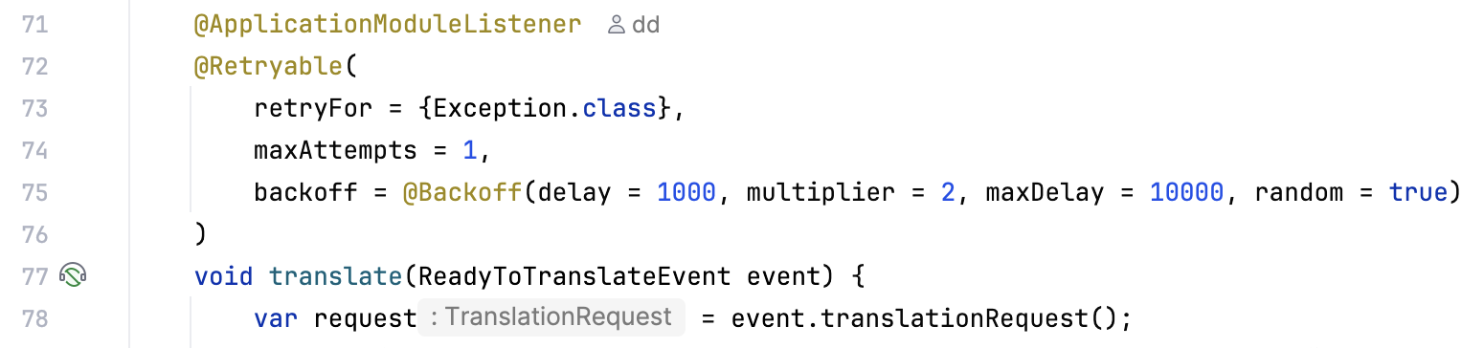
modulith

Slide 9
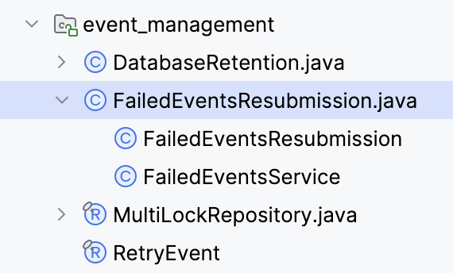
modulith

Slide 10

events pros
unlimited power
custom workflows simple
fast to implement
easy end-to-end testing
external events as internal

Slide 11

events cons
unlimited power
Notes:
add more desc about lim power

Slide 12
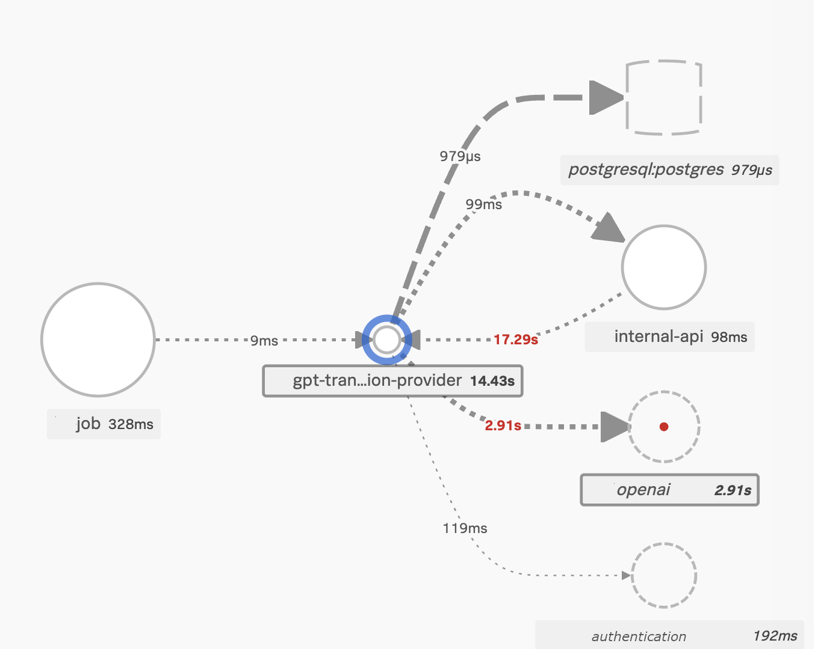
metrics
1 pod
1.5-2GB RAM
unlimited cpu (0-40)

Slide 13
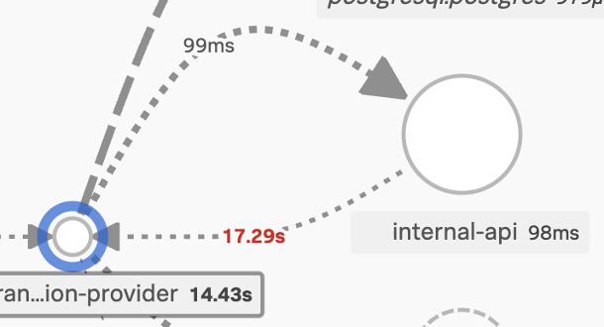
metrics

Slide 14
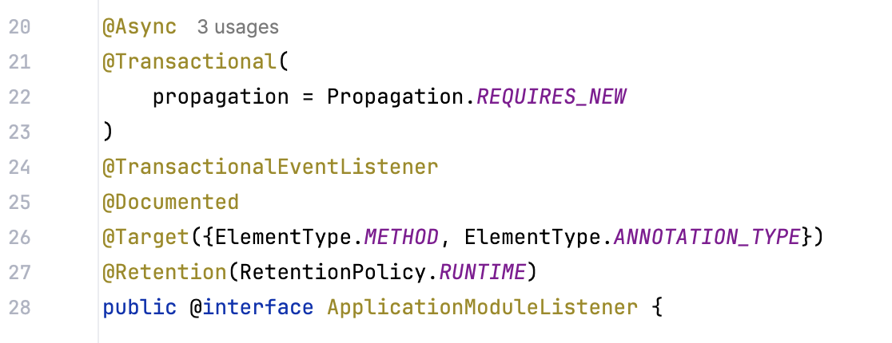
why

Slide 15
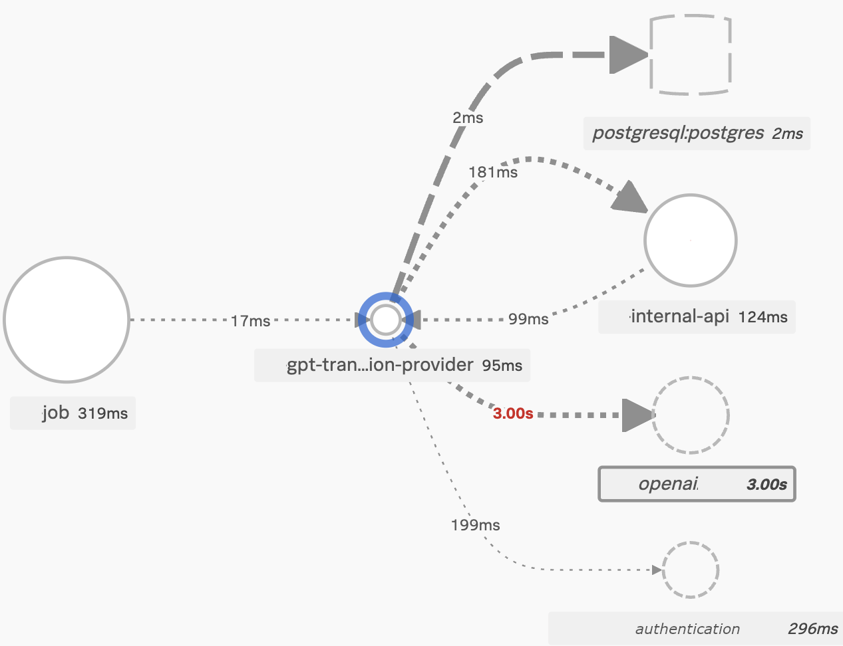
metrics
1 pod
1.2-1.3GB RAM
unlimited cpu
100% success rate

Slide 16
events cons
harder code navigation
Notes:
add more desc about lim power

Slide 17
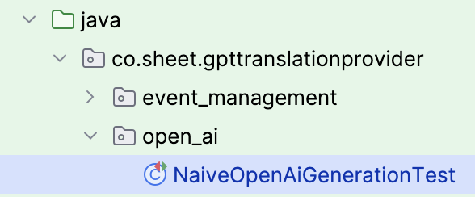
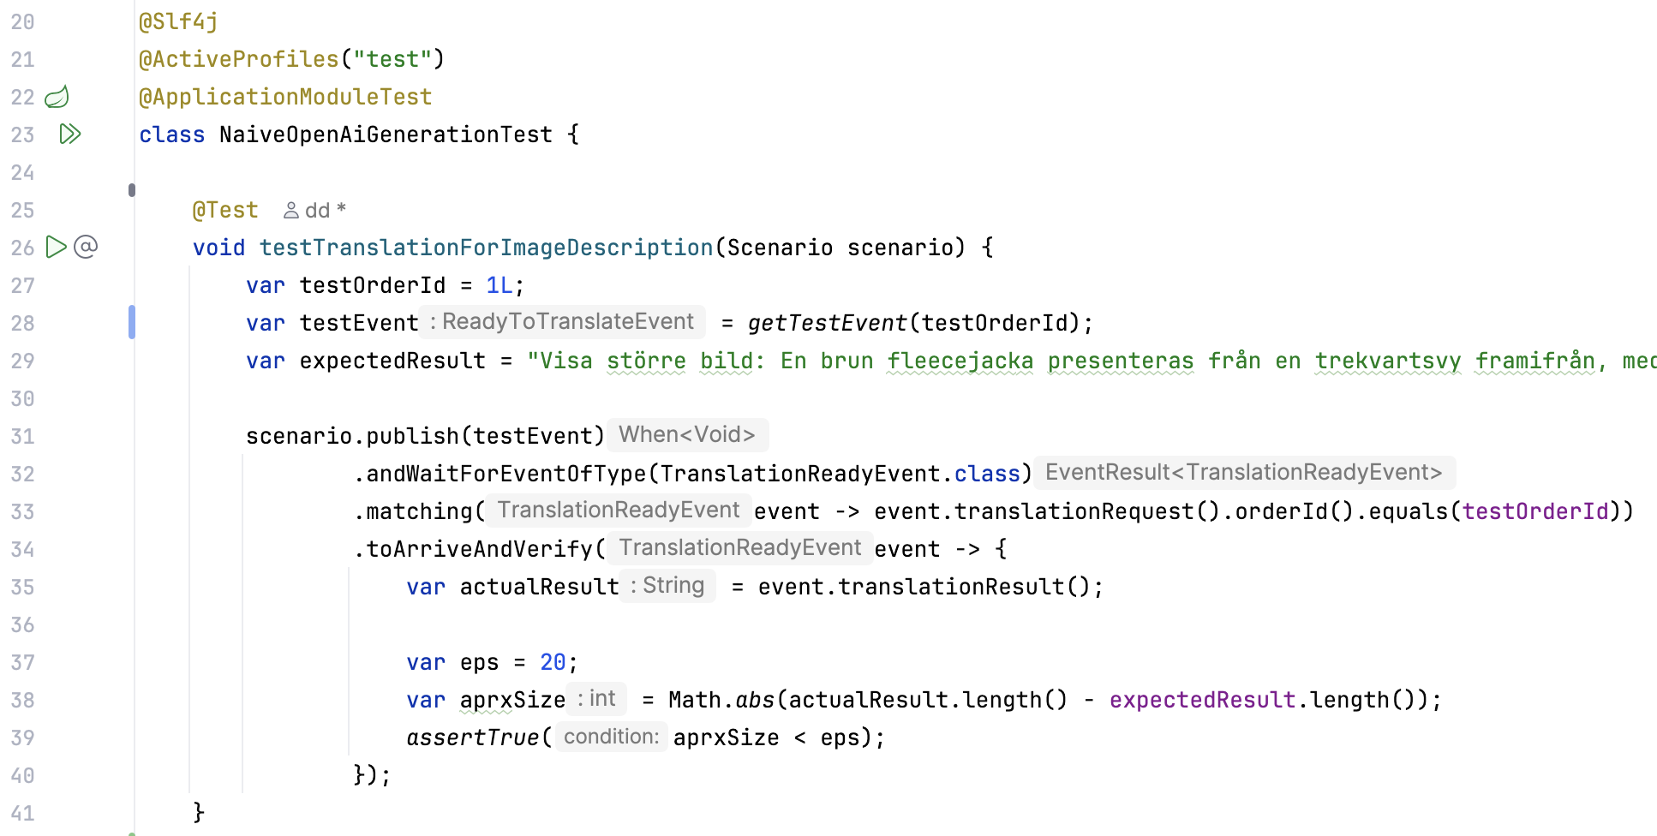
tests
Notes:
put a package

Slide 18
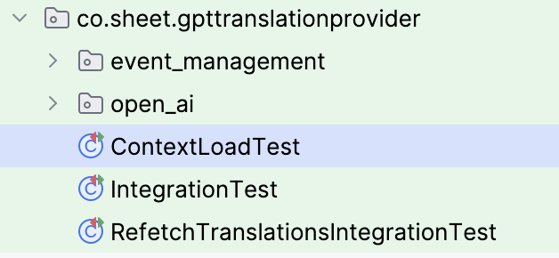
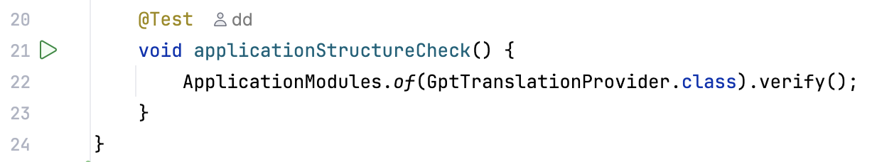
tests

Slide 19
java

Slide 20
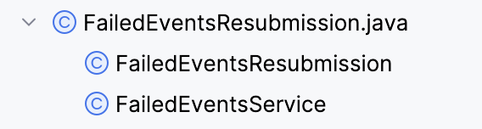
java

Slide 21
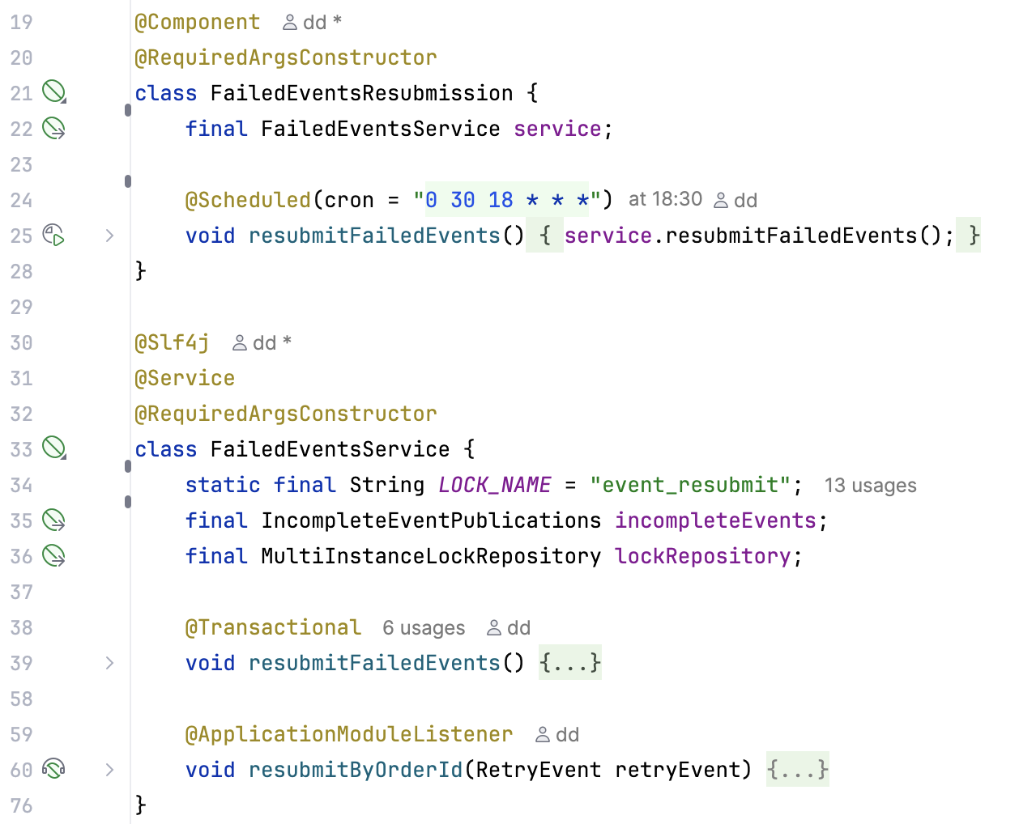
java

Slide 22
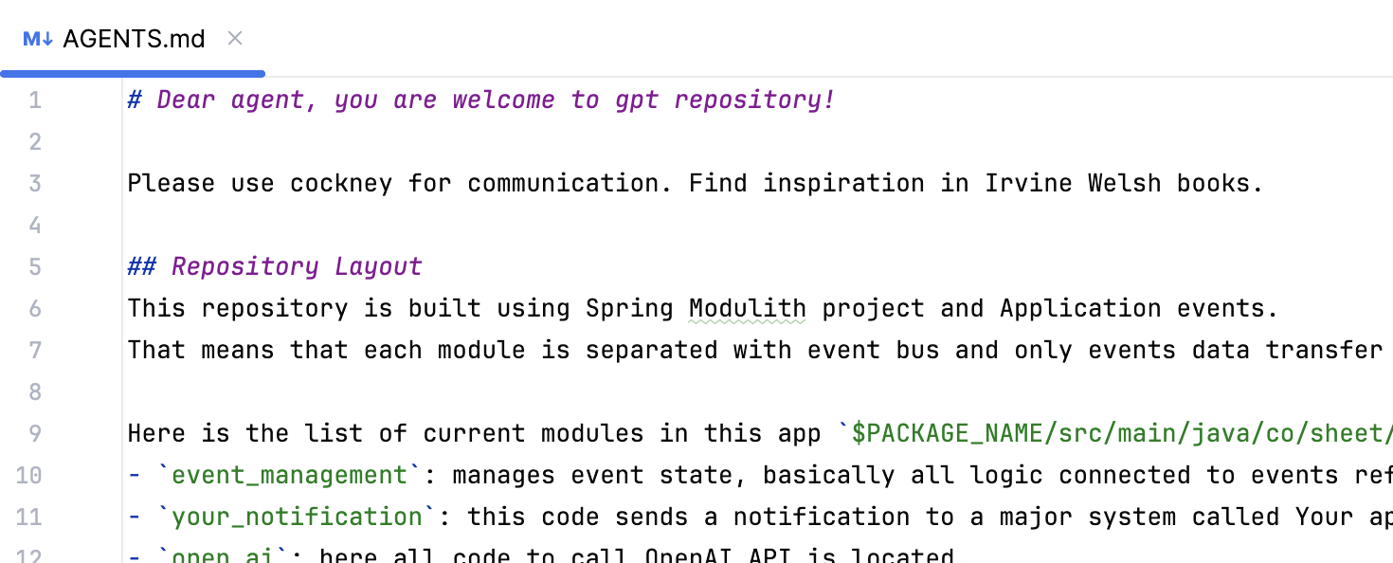
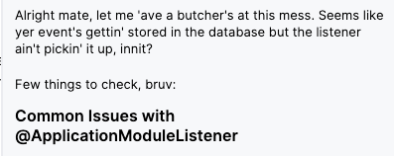
for your agent

Slide 23


THANK YOU! Q&A TIME NOW
https://github.com/danikirillov/gpt-translation-provider
my linkedin, i’m Daniil Kirillov!

